Slide 1

REAL-TIME FACE RECOGNITION FOR SMART ATTENDANCE SYSTEM
By
s.harini
g.deeksha
k.s.abhishalni
A.jenisha sherine
t.k.skousiga

Slide 2

INTRODUCTION
  Face recognition → identifies people from facial images.
  Deep Learning (CNN) improves speed & accuracy.
  Used for a surveillance, and authentication.

Slide 3
OBJECTIVES
  Implement real-time face detection & recognition.
  Compare CNN models for accuracy.
  Automate attendance marking through recognition.

Slide 4
DATASET DETAILS
  Dataset: Labeled Faces in the Wild (LFW)
  Total Images: 13 000 +
  Unique Persons: 1 680 +
  Image Size: 62 × 47 px (resized)
  Loaded directly from Scikit-learn / UMass source.

Slide 5
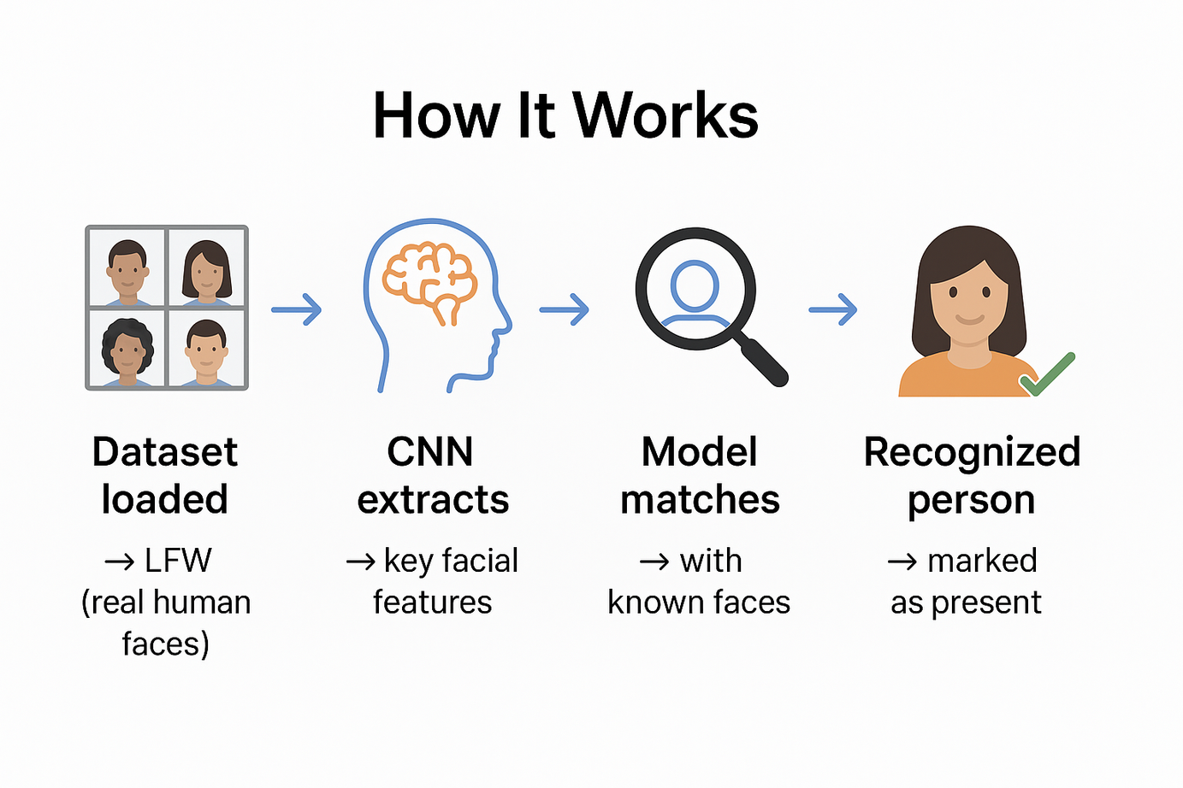
WORK FLOW

Slide 6
DATA SPLITTING
  The dataset is divided into two parts — Training and Testing sets.
  80% of data is used for training to help the model learn facial features.
  20% of data is used for testing to validate recognition accuracy.
  This split ensures the model performs well on new, unseen faces.

Slide 7
MODEL USED: VGG-FACE
  Deep CNN pre-trained on 2.6 M face images.
  Extracts detailed facial embeddings.
  Chosen because of high accuracy (≈ 97 %) and reliability.
  Performs better than Facenet, OpenFace, DeepID models.

Slide 8
PROGRAM FLOW
  Load LFW dataset for training and testing.
  Preprocess images – resize, normalize, align faces.
  Extract facial features using VGG-Face model.
  Compare embeddings to find matching faces.
  Predict and display Actual vs Predicted .
  Mark attendance .

Slide 9
INPUT & OUPUT
  Input : Face image (used from database)
  Output : Recognized name + confidence score + attendance marked
  Example : “Recognized → Barack Obama (98.5 %) – Present”

Slide 10
RESULT
  Accuracy: ~97% using VGG-Face model.
  Faces recognized under varied lighting and pose.
  Performed better than Facenet and OpenFace.
  Reliable and consistent for real-time recognition.
  Attendance successfully recorded for recognized users.

Slide 11
CONCLUSION
  Deep Learning offers accurate and fast face recognition.
  VGG-Face gave highest accuracy for our dataset.
  Effective for real-time attendance applications.
  Reliable and efficient Deep Learning approach.

Slide 12
THANK YOU

